Slide 1
People, politics And power
Trevor Bowens
Angel Cahill
Dimpal Gajjar
T.J. Zientek

Slide 2
Methodology used
Evaluate Interest rates pull the data primary data over time.
Focus on primary data 1980 to 2016 years
Separated data in political party and power
Democratic
Republican
Impact the house hold data used Bread, Alcohol, Mortgage Rate

Slide 3
Used Kaggle & Federal Government data
Machin Learning
Combine CSV data using Pandas.(President, Senator, Representative, Bread Prices, Interest Rate, Alcohol, 30 years treasury Data)
Visualized all the Data by creating a story in Tableau
CSV data combined using python & Pandas by years 1980 to 2016

Slide 4
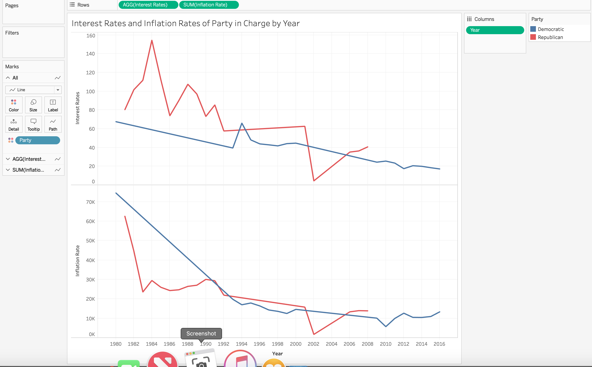
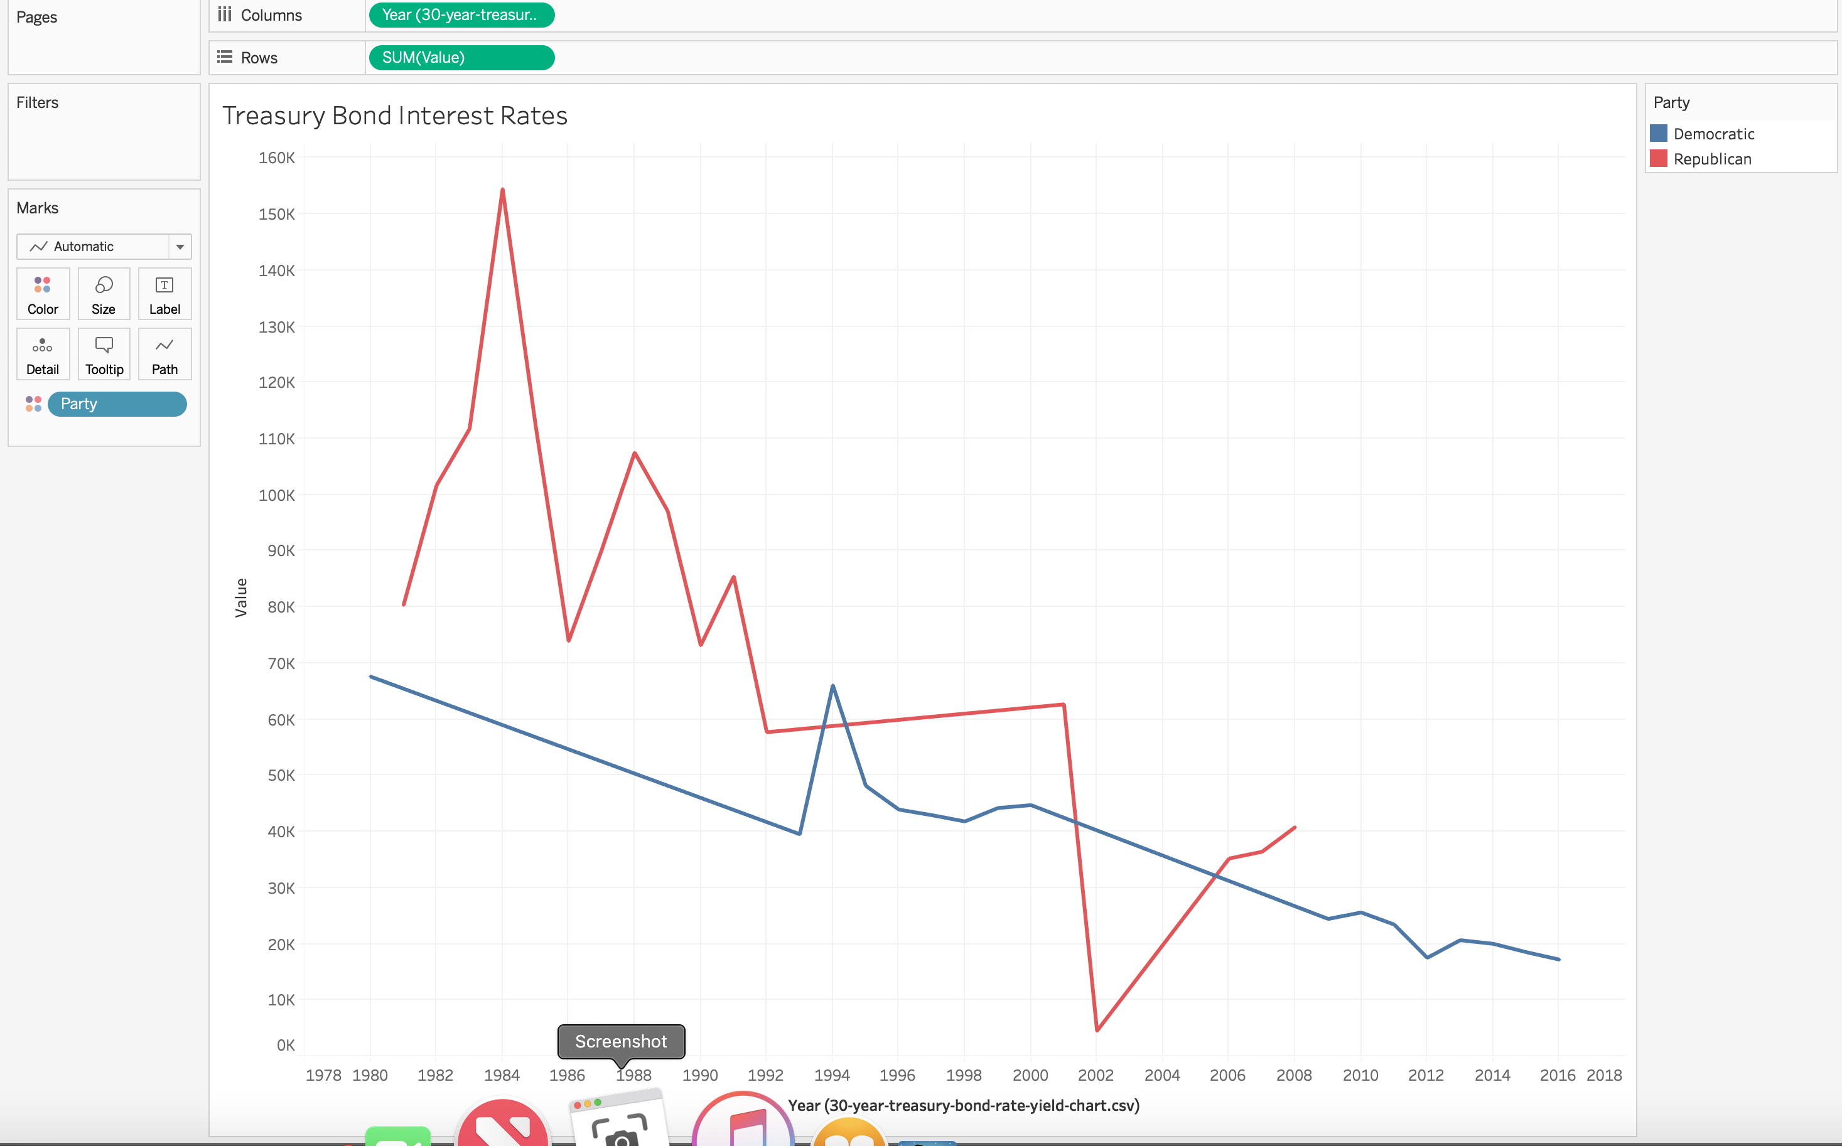
Interest Rates and Inflation Rates Party
Treasury Bond Interest Rates
Interest rates appear to be higher when the republican party is in power. The democratic party overall maintains a lower interest rate when they are in power.
The inflation was high in the 80’s,but appears to level out to a lower trend in the 2000’s.
The treasury bond rate and the mortgage rate are the same across the board, so you can see that the rates appear to trend downward after 1894; however it appears that overall the democratic party maintains a lower treasury bond rate over.
Notes:
Interest rates appear to be higher when the republican party is in power. The democratic party overall maintains a lower interest rate when they are in power.
The inflation was high in the 80’s,but appears to level out to a lower trend in the 2000’s.
The treasury bond rate and the mortgage rate are the same across the board, so you can see that the rates appear to trend downward after 1894; however it appears that overall the democratic party maintains a lower treasury bond rate overe

Slide 5
STORY

Slide 6
Correlation ≠ Causation

Slide 7





TECHNOLOGY USED
EXCEL
PYTHON
PANDA
TABLEAU
SK LEARN/Sci Kit

Slide 8

QUESTION

